Slide 1
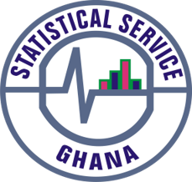
PRESS RELEASE
GHANA, JUNE 2022
CONSUMER PRICE INDEX AND INFLATION
13th July 2022

Slide 2
In this release, we present:
Definition and Measurement of Consumer Price Index (CPI) and Rate of Inflation
CPI and Rate of Inflation for June 2022
Dominant Divisions of Rate of Inflation for June 2022
Disaggregation of Rate of Inflation for June 2022
Highlights of CPI and Rate of Inflation for June 2022

Slide 3
Definition and measurement of CPI and rate of inflation (1/3)
CPI measures changes in the price of a fixed basket of goods and services purchased by households
The assumption is that the basket is purchased each month, hence as price changes each month, the total price of the basket will also change
The rate of inflation is the relative change in CPI between periods
Inflation is reported year-on-year (annual inflation) and month-on-month (monthly inflation), and granulated to determine regional and commodity type and source of inflation
2
2

Slide 4
Definition and measurement of CPI and rate of inflation (2/3)
CPI does not measure price levels
CPI is a price perspective measure and cost-of-living index is an expenditure oriented measure
Data (market readings) are captured monthly
Key variables are prices, quantities and expenditure weights of items
Price reference year is 2018 (2018 = 100)
3

Slide 5
Definition and measurement of CPI and rate of inflation (3/3)
Prices are collected for approximately 39,500 products every month.
Price collection is done in 44 markets
Prices are collected from 7,726 outlets.
Products are ordered in a hierarchy of 13 Divisions, 44 Groups, 98 Classes, 156 Subclasses and 307 Items.
Every Item can only be part of one Subclass, and every Subclass can only be part of one Class, etc.
4

Slide 6
Consumer Price Index and Rate of Inflation for June. 2022
CPI for June 2022 was 167.7 relative to 129.2 in June 2021
Year-on-year inflation rate for June 2022 was 29.8%
This means that in the month of June 2022 the general price level was 29.8% higher than June 2021
Month-on-month inflation between May 2022 and June 2022 was 3.0%
Month | CPI | Inflation |  | Quarterly Averages
 |  | Monthly | Yearly | Quarterly Averages
May-2021 | 127.6 | 0.8% | 7.5%
June-2021 | 129.2 | 1.3% | 7.8%
Jul-2021 | 131.3 | 1.6% | 9.0% | Q3: 9.8%
Aug-2021 | 131.7 | 0.3% | 9.7%
Sept-2021 | 132.5 | 0.6% | 10.6%
Oct-2021 | 133.3 | 0.6% | 11.0% | Q4: 11.9%
Nov-2021 | 135.2 | 1.4% | 12.2%
Dec-2021 | 136.9 | 1.2% | 12.6%
Jan-2022 | 139.7 | 2.1% | 13.9% | Q1: 16.3%
Feb-2022 | 143.0 | 2.4% | 15.7%
Mar-2022 | 148.8 | 4.0% | 19.4%
Apr-2022 | 156.5 | 5.1% | 23.6% | Q2: 27.0%
May-2022 | 162.8 | 4.1% | 27.6%
June-2022 | 167.7 | 3.0% | 29.8%
5
Notes:
Relative to May 2022, year-on-year inflation increased by 2.2 percentage points in June 2022 and month-on-month inflation dropped by 0.9 percentage points over the same period.
On a quarterly basis average rate of inflation has increased by 10.7 percentage points in the second quarter (27.0%) of 2022 relative to the first quarter (16.3%).

Slide 7
Disaggregation of June 2022 rate of inflation
Food inflation (0.437) was 30.7%
  Last month this was 30.1%
  Average over last 12 month was 17.5%
  Month-on-month Food inflation was 2.3%.
Non-food Inflation (0.563) was 29.1%
  Last month this was 25.7 %
  Average over last 12 month was 15.3%
  Month-on-month Non-Food inflation was 3.6%
Inflation for locally produced items was 29.2%
Inflation for imported items was 31.3%
6
Notes:
On year-on-year basis, the difference between food inflation (30.7%) and Non-food (29.1%) was 1.6 percentage points.
On month-on-month basis, non-food inflation records a higher rate of 3.6% relative to food (2.3%), leading to 1.3 percentage point difference.
The percentage point increase in Non-food inflation (3.4) between May and June 2022 is higher than food inflation (0.6).
The percentage point difference between inflation for imported items (31.3%) and locally domestic items (29.2%) was 2.1

Slide 8
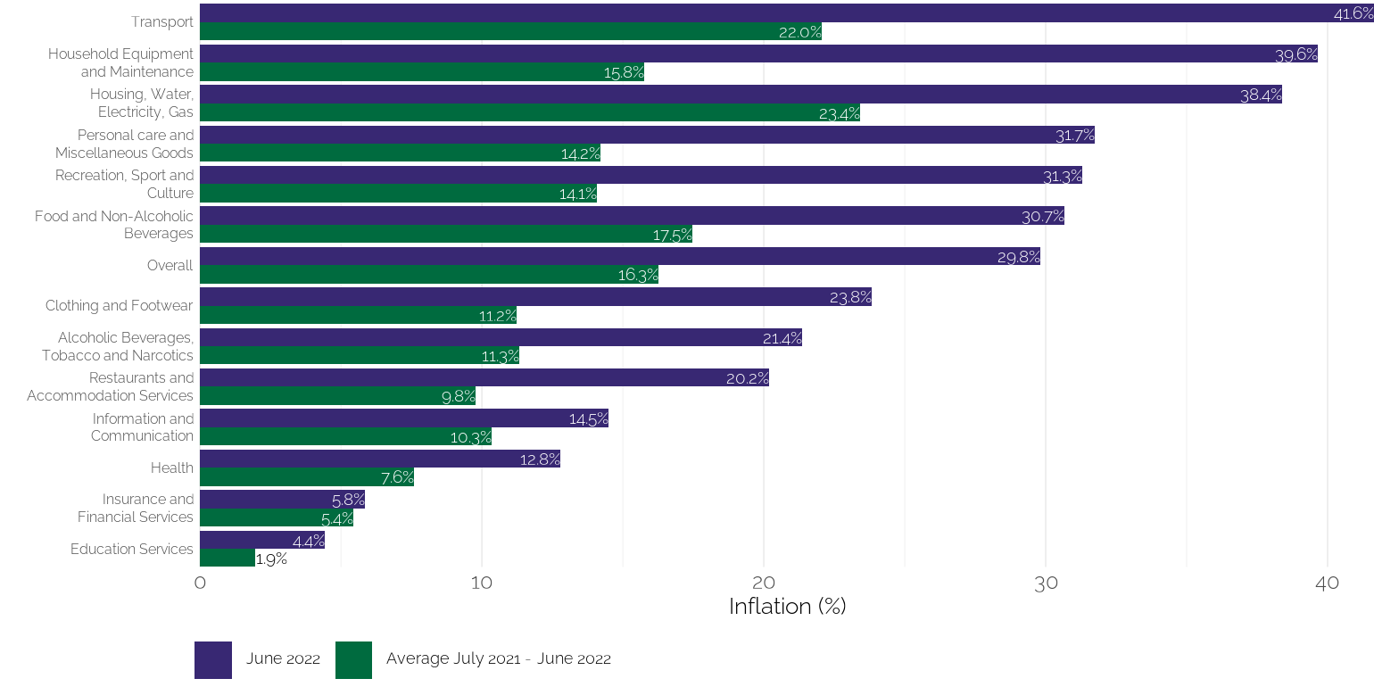
Disaggregation of year-on-year inflation by Division (2/2)
7
Notes:
Six {Transport (41.6%), Household Equipment and Maintenance (39.6%), Housing, Water, Electricity and Gas (38.4%), Personal Care and Miscellaneous Goods (31.7%), Recreation, Sports and Culture (31.3%) and Food and Non-Alcoholic Beverages (30.7%)} out of the 13 divisions recorded inflation rates higher than the national average (29.8%).
All 13 divisions for the computation of inflation recorded rates higher than the rolling average for the July 2021 to June 2022 with six of the divisions surging more than twice.

Slide 9
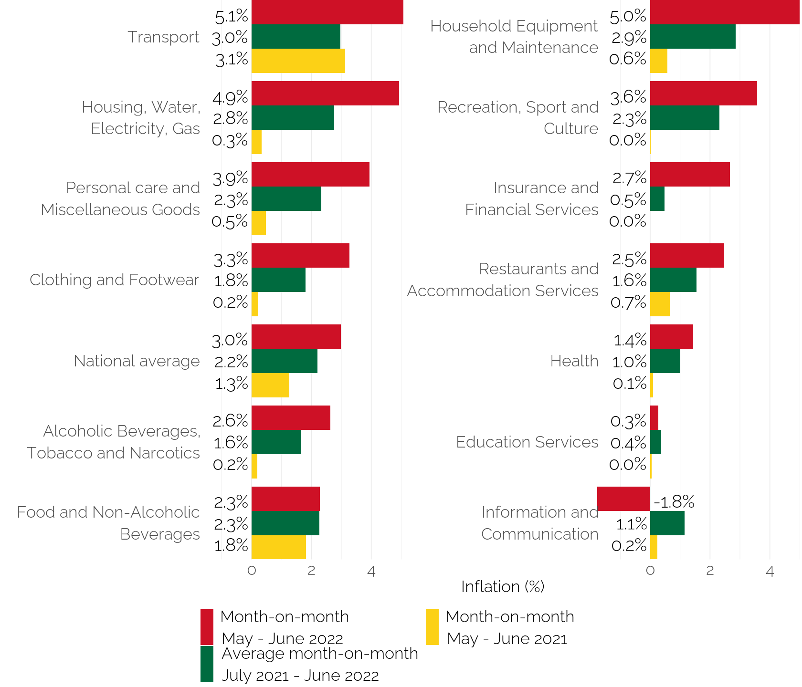
Disaggregation of month-on-month inflation
Notes:
Also on a month-on-month basis six divisions {Transport (5.1%), Household Equipment and Maintenance (5.0), Housing, Water, Electricity and Gas (4.3%), Personal Care and Miscellaneous Goods (3.9%), Recreation, Sports and Culture (3.6%) and Clothing and Footwear(3.3%)} record inflation rates higher than the national average (3.0%)}.
Information and Communication recorded a deflation in June 2022 of 1.8%.

Slide 10
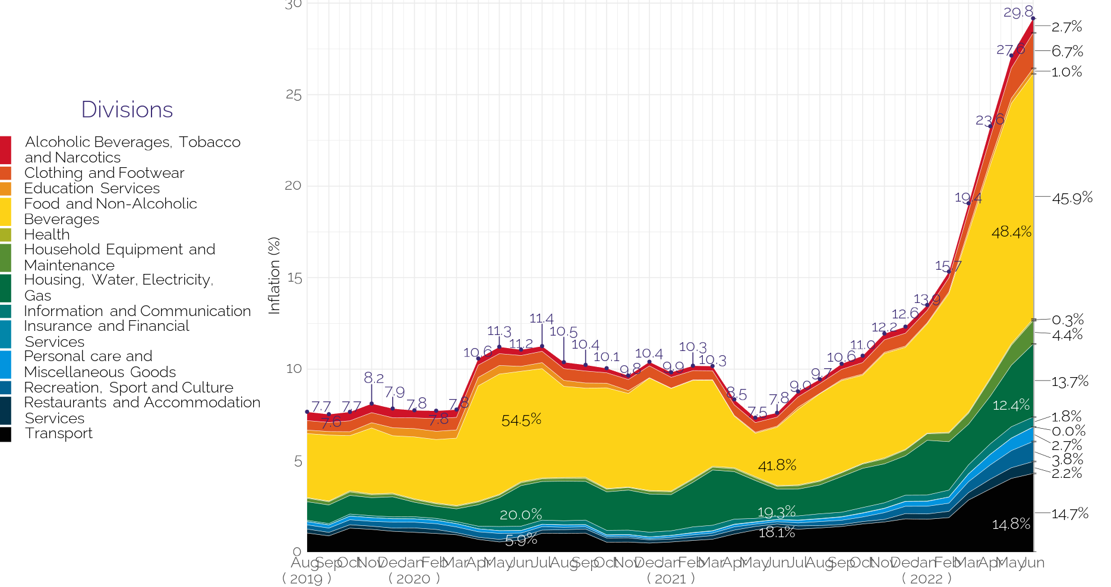
Contribution of year-on-year inflation
9
Notes:
While the contribution of Housing, Water, Electricity and Gas (13.7%) increased by 1.3 percentage points between May and June 2022, food inflation (45.9%) reduced by 2.5 percentage points and Transport also marginally reduced by 0.1 percentage points.

Slide 11
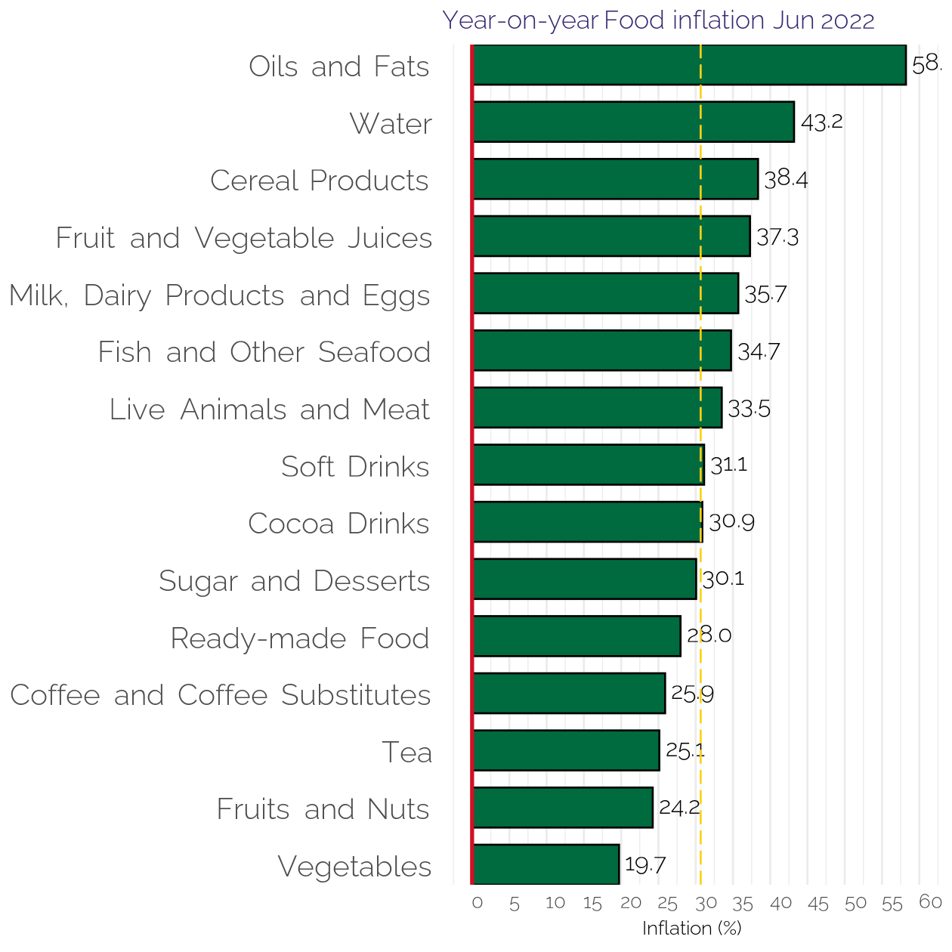
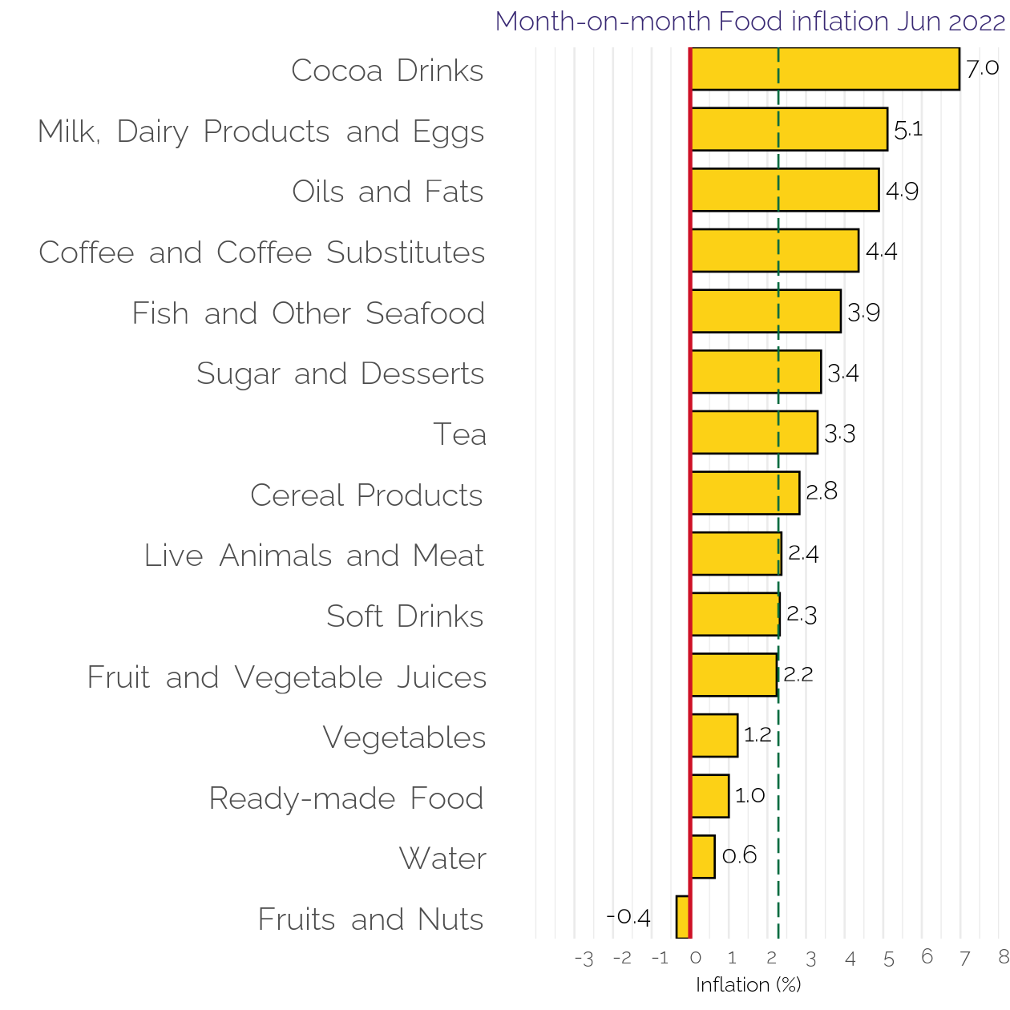
Disaggregation of YoY and MoM Food-inflation by Subclass
10
Notes:
Focusing on food inflation on a year-on-year basis (30.7%) for June 2022, nine subclasses recorded higher rates. This was distantly led by Oils and Fats (58.0%) followed by Water (43.2%) and Cereal Products (38.4%). In the case of month-on-month food inflation XXX subclasses record rates higher than than the national average (4.0%).

Slide 12
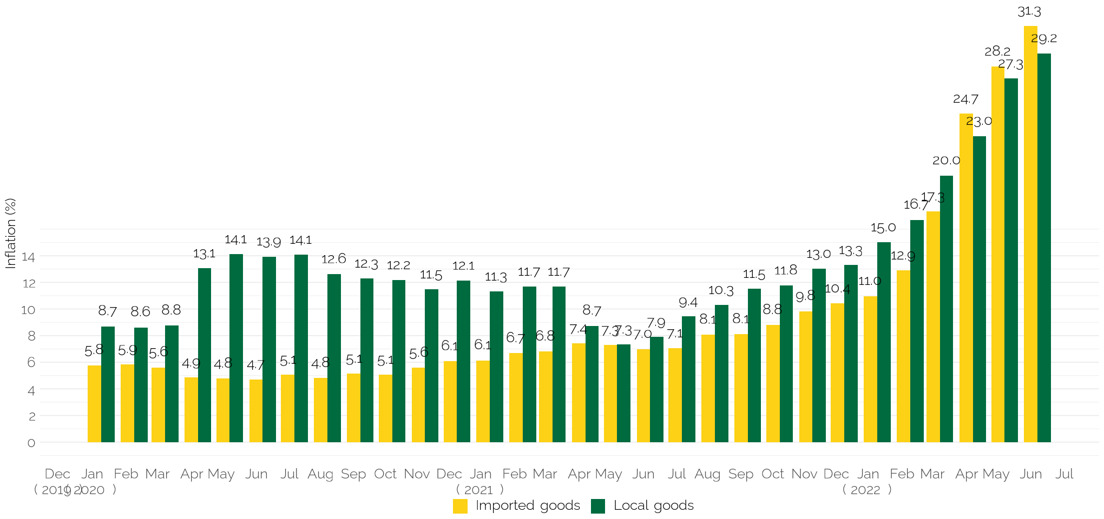
Imported and local inflation January 2020 – June 2022
Notes:
For the third month in a row (since April 2022) imported items record higher inflation rates than locally produced items. The gap widened in June 2022 (2.1 percentage points) relative to the variations recorded in both April (1.7 percentage points) and May (0.9 percentage points).

Slide 13
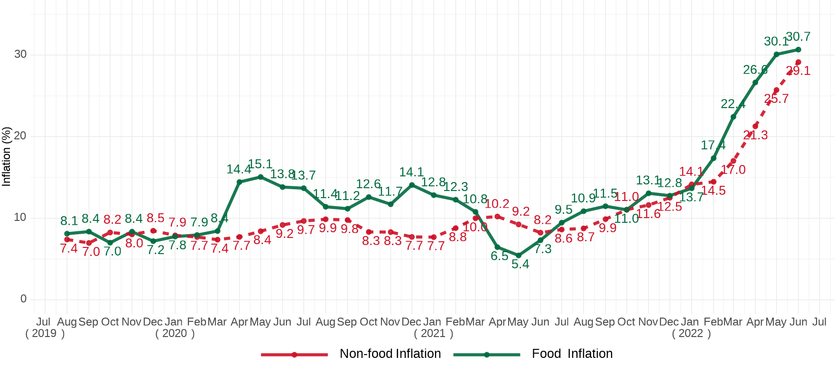
Food & Non-Food year-on-year inflation Jul. 19–June. 22

Slide 14
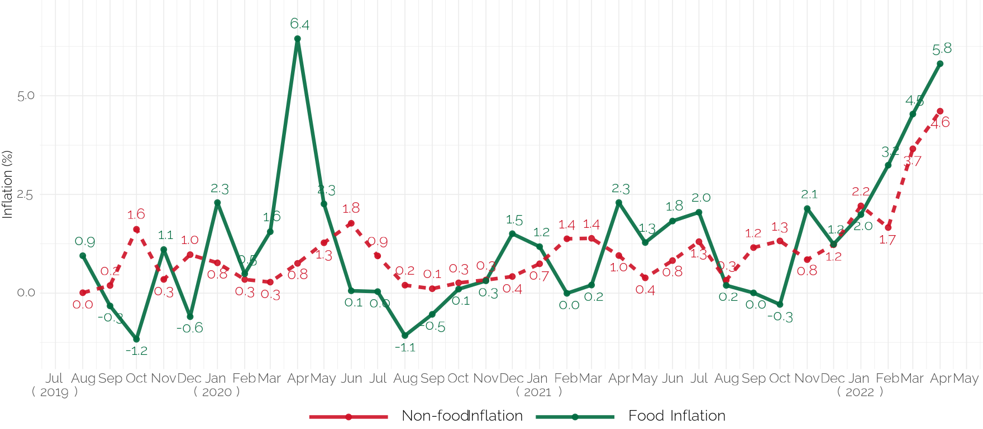
Food & Non-Food month-on-month inflation Aug. 2019–June. 2022

Slide 15
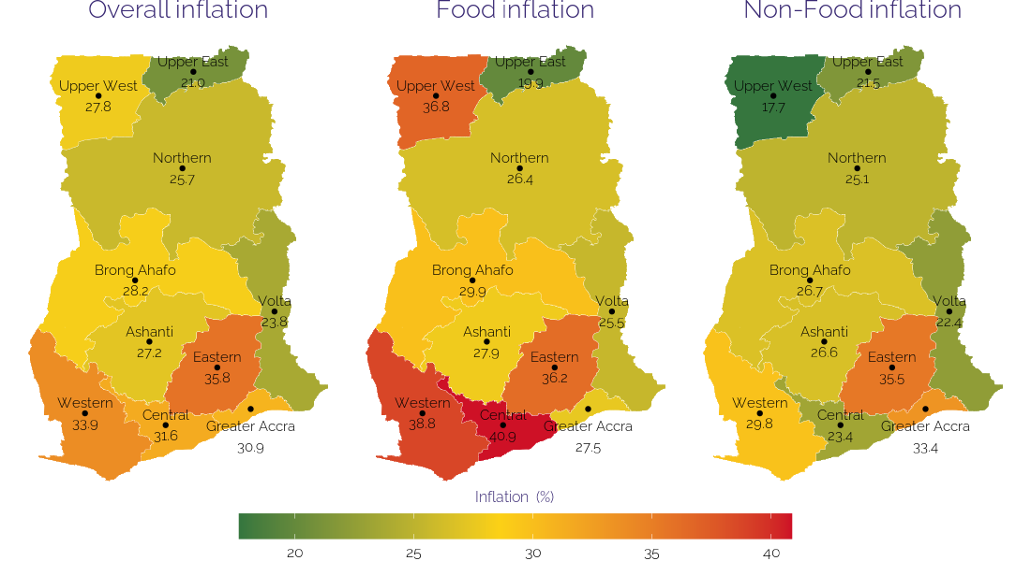
June 2022 regional rates of inflation
14
Notes:
Centrals Region recorded highest food inflation (40.9%) and Eastern Region, the highest non-food inflation (35.5%). Overall eastern Region recorded the overall highest inflation (35.8%) followed by Western Region 33.9% and Central Region (31.6%). While Greater Accra recorded the fourth highest rate of inflation 30.9% it should be noted that it weight to the computation of inflation is XXX

Slide 16
Disaggregation of inflation in Eastern and Central Regions for June 2022
15
Notes:
Transport (64.5%) recorded the highest rate of inflation in the Eastern Region, for food inflation in the Central Region Oils and Fats had the highest rate of inflation of 63.5%.

Slide 17
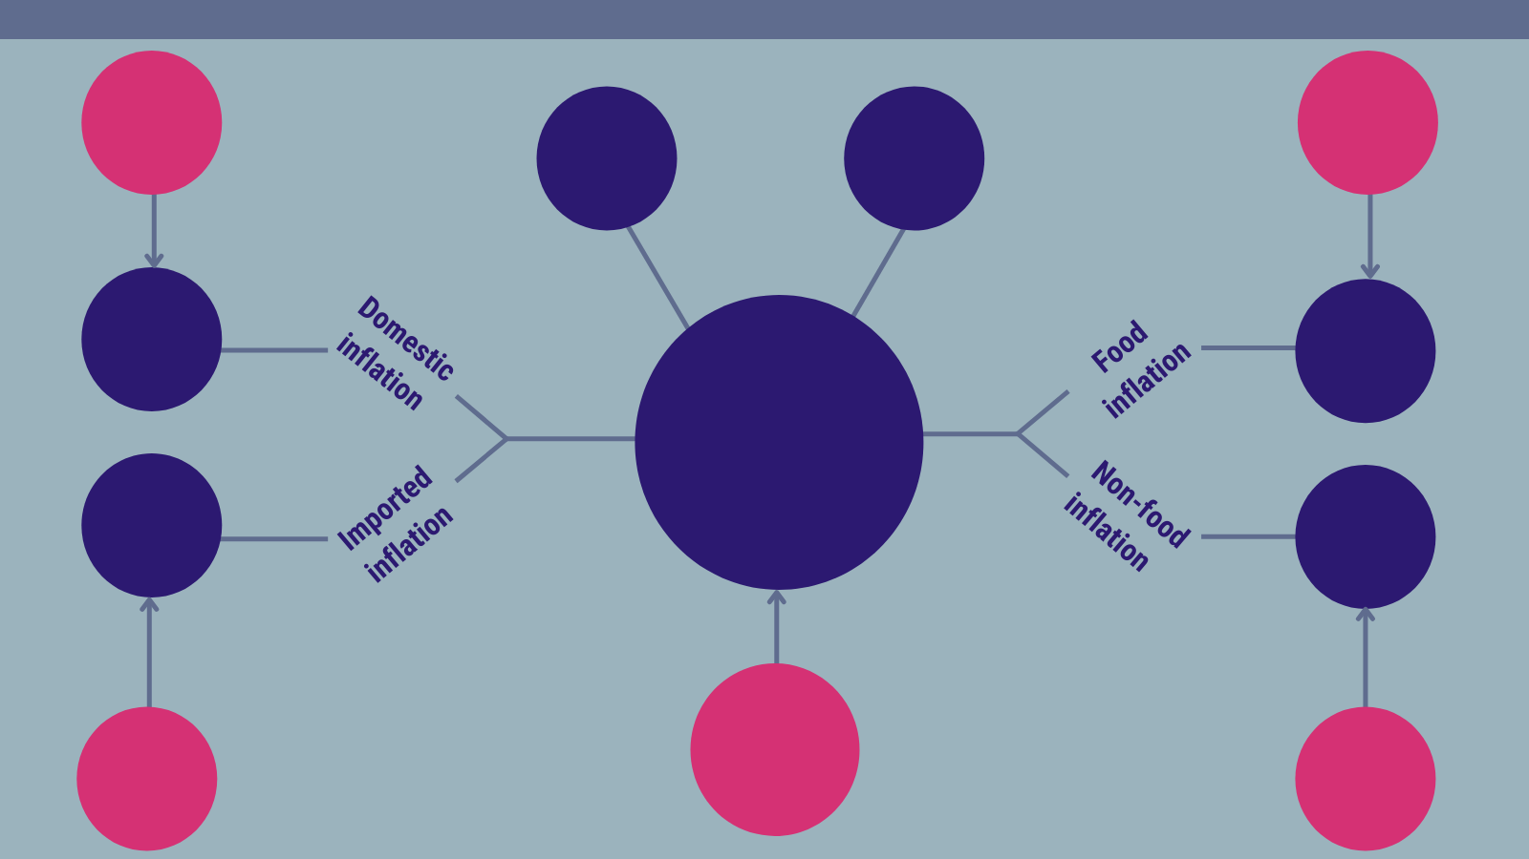
Highlights
27.3%
Domestic inflation
May 2022
30.1%
Food inflation
May 2022
35.8%
Highest regional inflation rate
(Eastern)
21.0%
Lowest regional inflation rate
(Upper East)
29.2%
30.7%
29.8%
Year-on-year inflation
June 2022
31.3%
29.1%
27.6%
Year-on-year inflation
May 2022
28.2%
Imported inflation
May 2022
25.7%
Non-food inflation
May 2022

Slide 18
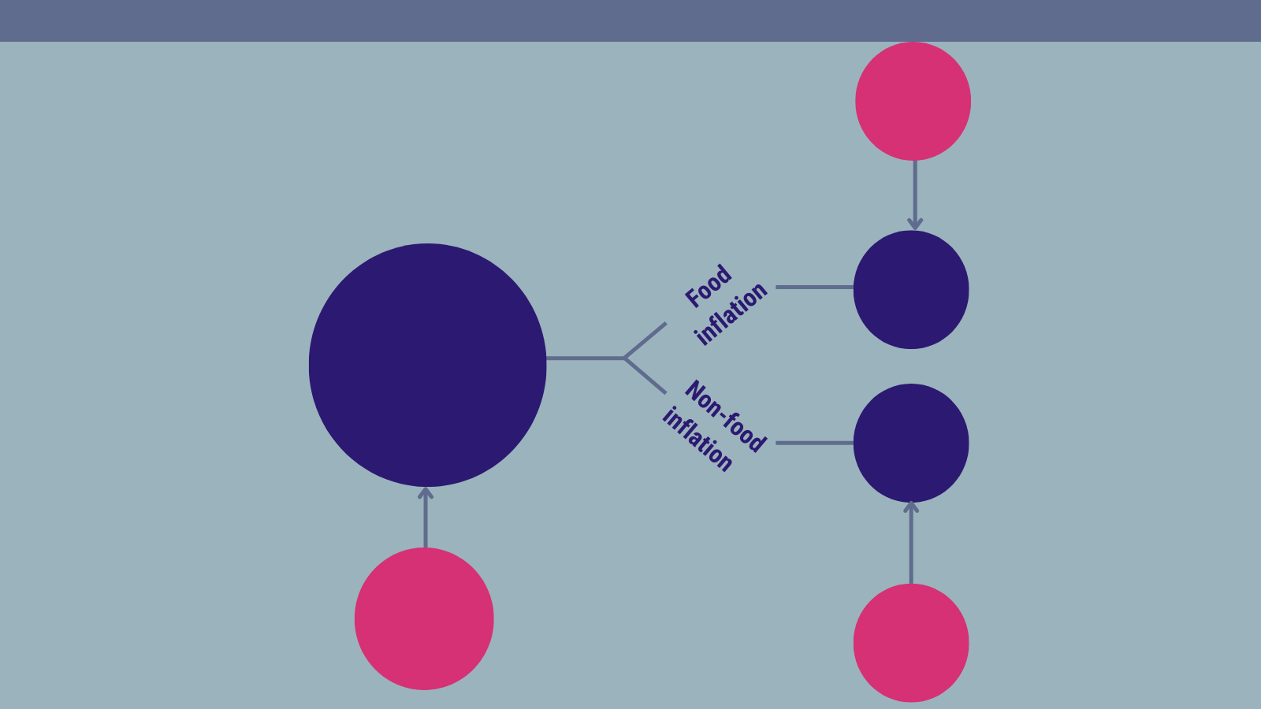
Highlights (2/2)
4.0%
Food inflation
May 2022
3.0%
Month-on-month inflation
June 2022
2.3%
3.6%
4.1%
Month-on-month inflation
May 2022
4.1%
Non-food inflation
May 2022

Slide 19
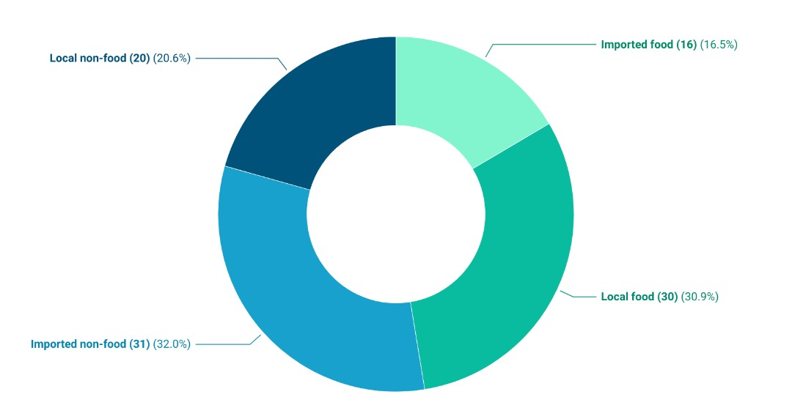
Additional Policy Considerations (1/2)
18
Notes:
Ninety-seven out of the 307 recorded rates higher than the national average with more than half (52.6%) being non-food items or locally produced items (51.5%).

Slide 20
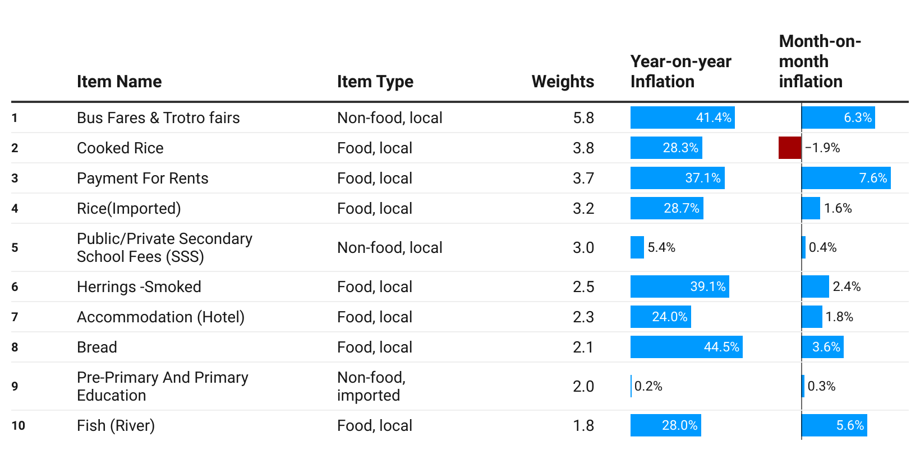
Additional Policy Considerations (2/2)
19

Slide 21
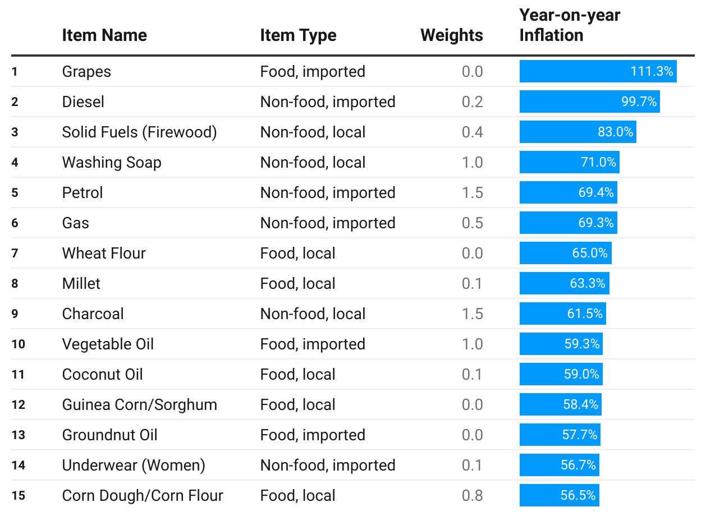
Additional Pointers for Household Decision Making
The inflation rates recorded each month have differential impacts on household depending on the basket of items purchased by each household.
Given households’ taste, disposal income and availability of alternatives, the basket of items purchased can be varied in response to the soaring prices.
Top fifteen items with the highest upward change in year-on-year inflation rates for April 2022.
20

Slide 22
End of Press Release for
June 2022 Consumer Price Index
For enquiries, please contact:
https://statsghana.gov.gh/gssmain/fileUpload/Price%20Indices/CPI_Technical_Guide_v5_Published_14102020.pdf
Mr. John F.K. Agyaho
(Head, Price Statistics, GSS)
john.agyaho@statsghana.gov.gh

Slide 23
Consumer Price Index and Inflation
June 2022

